Slide 2
Our framework in a nutshell
Sensitivity analysis (Sobol indices); via testSensitivity.m and initialize.m
Model (AeroModule)
Input uncertainties (defined in NM80.m or NewMexico.m or …)
QoI, e.g. total blade force, sectional blade force (defined in NM80_readoutput.m)
Calibration (Bayesian inference); via testCalibration.m and initialize_calibration.m
Model + surrogate model (Aeromodule), surrogate defined in initialize
Input uncertainties (prior) + prior for hyperparameters
QoI (see above)
Measurement data
Multiple operating conditions: Calibrate_multipleruns.m

Slide 3
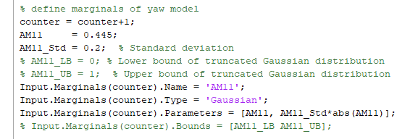
Our framework in a nutshell
Input parameterization:
‘Simple’ (scalar) parameters: make sure that the name in the Input object matches the name in the input.txt or specialist_input.txt file
Lift/drag/moment: name should be CL, CD, CM. See NM80 case for example.
Twist, chord uncertainty (parameterization as function of radius): implementation to be finished.

Slide 4
Our framework in a nutshell
Output parameterization:
‘Simple’ (scalar) output, e.g. mean of total blade force, or mean of sectional blade force: nothing needed.
High-dimensional vector output, e.g. azimuth-dependent force: compress data with Fourier transform into a few coefficients. Sensitivity is wrt these coefficients. Calibration by comparing Fourier transform of model to Fourier transform of measurements. Surrogate model is for the coefficients as a function of uncertain parameters.

Slide 5
NM80 - parameterization

Slide 6
NM80 - parameterization
F_n = 0.5*rho*V^2*c*(CL*cos(beta)+CD*sin(beta))
dF_n/dCL = 0.5*rho*V^2*c*cos(beta)
C_n = CL*cos(beta)+CD*sin(beta)
dC_n/dCL = cos(beta)

Slide 7
NM80 - parameterization

Slide 8
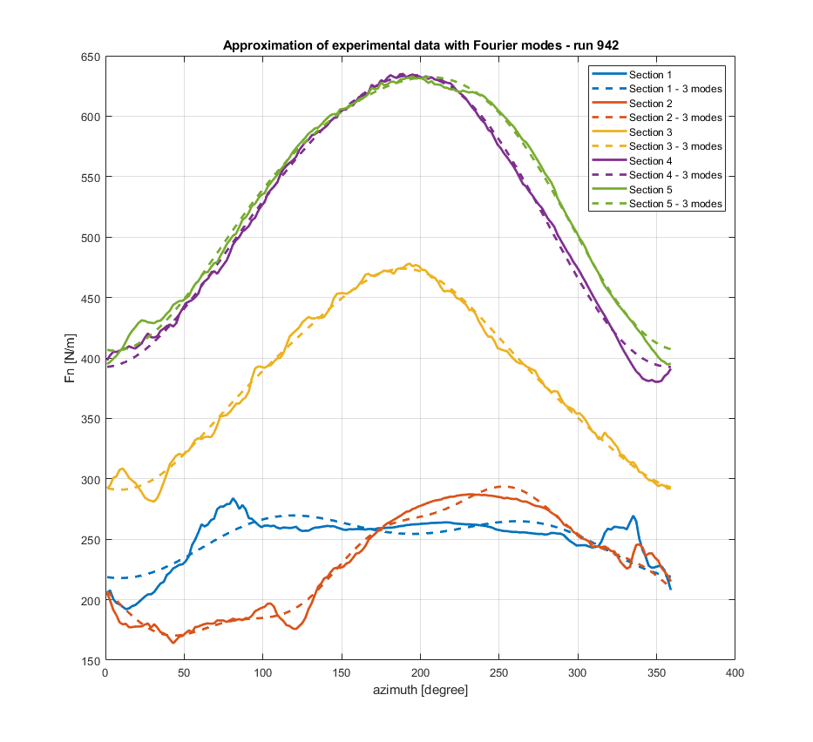
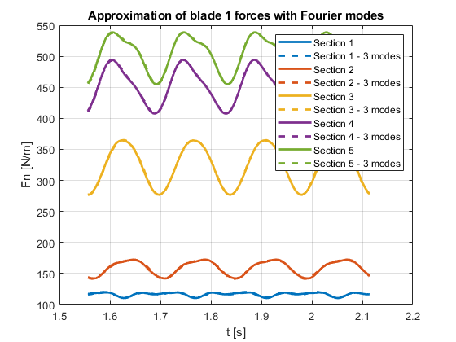
New Mexico – output parameterization

Slide 9
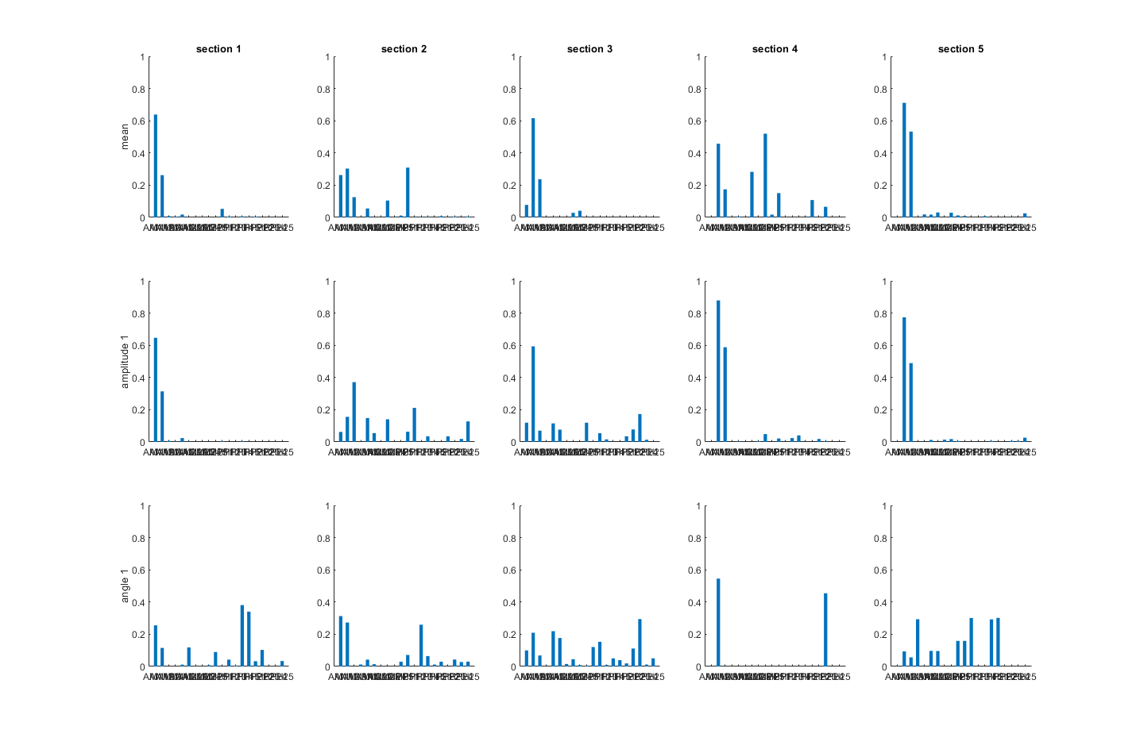
New Mexico - sensitivity

Slide 10
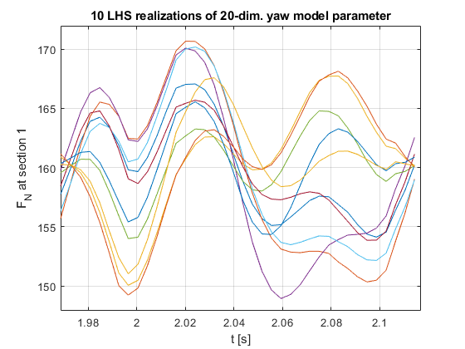
New Mexico – higher frequencies, run 941

